Slide 1

java Programming Project Presentation
Project Title: Job Application Tracking System for Students
Course: Mini Project
Student Name & Roll No: [Sudharsan S & 25BCS156]
Department: Computer Science
Mentor / Guide: [Name & Designation]

Slide 2
Introduction
JAVA
Pro gramming Project Presentation
The Job Application Tracking System for Students is a Java-based console application designed to help students manage and track their job applications efficiently. Many students apply to multiple companies and find it difficult to remember application details and statuses. This system provides a simple way to store, update, and view job application records such as company name, role, and status. It helps students stay organized and monitor their job search process.

Slide 3
Objective
JAVA
Programming Project Presentation
To design a job application tracking system
To store job application details
To track application status
To update application information
To search applications easily
To provide a simple console-based interface

Slide 4
Problem Statement
JAVA
Programming Project Presentation
Students face problems like:
Forgetting application details
Difficulty tracking multiple applications
No proper record maintenance
Confusion in status updates
No proper system to:
Track status (Applied/Interview/Selected)
Search company applications
Store application data
This project solves these problems using automation.

Slide 5
System Requirements
JAVA
Programming Project Presentation
Hardware Requirements:
Processor: Intel i3 or higher
RAM: 4GB minimum
Storage: 500MB
Software Requirements:
OS: Windows / Linux
Language: Java
IDE: Eclipse / IntelliJ / NetBeans

Slide 6
System Design
JAVA
Programming Project Presentation
The system consists of:
Application Input
Data Storage
Status Update
Search Function
Workflow:
User selects option
Enters application details
System stores data
User views or updates records
Search applications by company

Slide 7
Module Description
JAVA Programming Project Presentation
Input Module
Collects ID, company name, role, and status
Storage Module
Stores data using ArrayList
Display Module
Shows all applications
Update Module
Updates application status
Delete Module
Removes application records
Search Module
Searches applications by company

Slide 8
Algorithm / Flowchart
JAVA Programming Project Presentation
Start
Display menu options
Select operation
Add / View / Update / Delete / Search
Process user input
Store or modify data
Repeat until exit
Stop

Slide 9
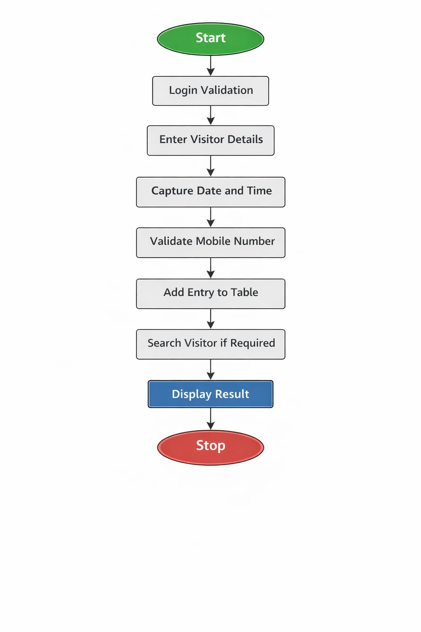
Flowchart
JAVA Programming Project Presentation

Slide 10
SOURCE CODE
JAVA Programming Project Presentation
import java.util.*;
public class Main {
// Inner class for Job Application
static class JobApplication {
int id;
String company;
String role;
String status;
JobApplication(int id, String company, String role, String status) {
this.id = id;
this.company = company;
this.role = role;
this.status = status;
}
void display() {
System.out.println("ID: " + id +
", Company: " + company +
", Role: " + role +
", Status: " + status);
}
}
static ArrayList<JobApplication> list = new ArrayList<>();
static Scanner sc = new Scanner(System.in);
public static void main(String[] args) {

Slide 11
SOURCE CODE
int choice;
do {
System.out.println("\n===== Job Application Tracker =====");
System.out.println("1. Add Application");
System.out.println("2. View Applications");
System.out.println("3. Update Status");
System.out.println("4. Delete Application");
System.out.println("5. Search by Company");
System.out.println("6. Exit");
System.out.print("Enter your choice: ");
choice = sc.nextInt();
switch (choice) {
case 1:
addApplication();
break;
case 2:
viewApplications();
break;
case 3:
updateStatus();
break;
case 4:
deleteApplication();
break;
case 5:
searchByCompany();
break;
case 6:
System.out.println("Thank you! Exiting...");
break;
JAVA Programming Project Presentation

Slide 12
SOURCE CODE
default:
System.out.println("Invalid choice!");
}
} while (choice != 6);
}
static void addApplication() {
System.out.print("Enter ID: ");
int id = sc.nextInt();
sc.nextLine(); // clear buffer
System.out.print("Enter Company Name: ");
String company = sc.nextLine();
System.out.print("Enter Role: ");
String role = sc.nextLine();
System.out.print("Enter Status (Applied/Interview/Rejected/Selected): ");
String status = sc.nextLine();
list.add(new JobApplication(id, company, role, status));
System.out.println("Application Added Successfully!");
}
static void viewApplications() {
if (list.isEmpty()) {
System.out.println("No applications found.");
return;
}
JAVA Programming Project Presentation

Slide 13
SOURCE CODE
System.out.println("\n--- All Applications ---");
for (JobApplication app : list) {
app.display();
}
}
static void updateStatus() {
System.out.print("Enter Application ID: ");
int id = sc.nextInt();
for (JobApplication app : list) {
if (app.id == id) {
sc.nextLine();
System.out.print("Enter New Status: ");
String newStatus = sc.nextLine();
app.status = newStatus;
System.out.println("Status Updated Successfully!");
return;
}
}
System.out.println("Application not found.");
}
static void deleteApplication() {
JAVA Programming Project Presentation

Slide 14
SOURCE CODE
System.out.print("Enter Application ID: ");
int id = sc.nextInt();
Iterator<JobApplication> it = list.iterator();
while (it.hasNext()) {
JobApplication app = it.next();
if (app.id == id) {
it.remove();
System.out.println("Application Deleted Successfully!");
return;
}
}
System.out.println("Application not found.");
}
static void searchByCompany() {
sc.nextLine();
System.out.print("Enter Company Name: ");
String company = sc.nextLine();
boolean found = false;
for (JobApplication app : list) {
if (app.company.equalsIgnoreCase(company)) {
app.display();
found = true;
}
}
if (!found) {
System.out.println("No applications found for this company.");
}
}
}
JAVA Programming Project Presentation

Slide 15
Implementation
JAVA Programming Project Presentation
Technologies used:
Java Programming
Collections (ArrayList)
OOP Concepts
Features implemented:
Add application
View applications
Update status
Delete application
Search by company

Slide 16
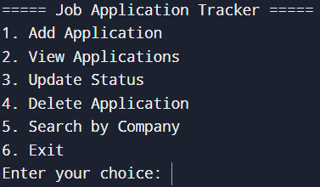
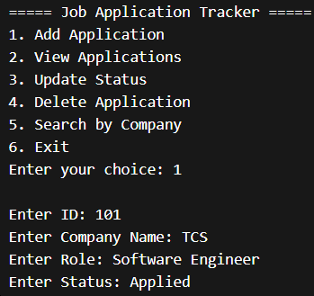
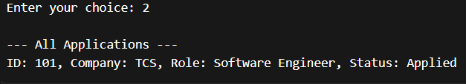
Output Screens
JAVA Programming Project Presentation

Slide 17
Results & Discussion
JAVA Programming Project Presentation
Successfully created job tracking system.
Users can:
Store application details
Track status
Search and update records
Challenges faced:
Managing data using collections
Handling user input
System helps students organize job applications.

Slide 18
Conclusion & Future Enhancement
JAVA Programming Project Presentation
Conclusion:
Project meets objectives
Improves data management skills
Simple and effective system
Future Enhancements:
Add GUI interface
Add database (MySQL)
Add reminders/notifications
Export reports

Slide 19
References / Acknowledgement
JAVA Programming Project Presentation
References:
Java Programming – E. Balagurusamy
Oracle Java Documentation
Online tutorials
Acknowledgement:
Thanks to guide and department

Slide 20
Thank You
Questions & Discussions

